Slide 1
UCI Dateset Online Retail
Customer
Segmentation
UCI Dateset Online Retail
DSI 10 Ivy Chan

Slide 2
CONTENTS
Problem Statement
Dataset
Data Cleaning
EDA
Features
Model
Conclusion & Recommendation

Slide 3
Problem Statement
Why Customer Segmentation?
Customers' needs or desires
Optimize customer journeys
Maximize customer potential value
Common Practice uses RFM Analysis
This project uses unsupervised machine learning approach to cluster customers into segments.
Notes:
To understand how to address the ; To understand how to address the

Slide 4
Problem Statement
Numerous type of customer segmentation:
Demogaphic
Geographical
Lifestage of customers
Benefit
Behavioural
Notes:
To understand how to address the ; To understand how to address the

Slide 5
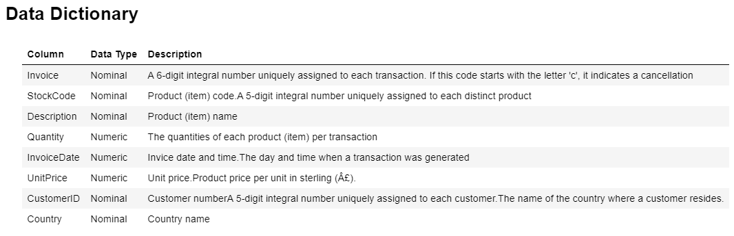
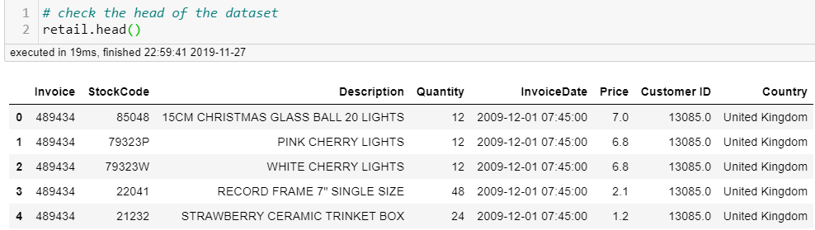
Dataset
Source:https://archive.ics.uci.edu/ml/datasets/Online+Retail+II

Slide 6
This dataframe consist data from 2009-12-01 07:45:00
This dataframe consist data ends on 2011-12-09 12:50:00
There are in total 738 days 05:05:00 days of observations.
The duration of the dataset is for 25 months.
Dataset
Source:https://archive.ics.uci.edu/ml/datasets/Online+Retail+II
From 2009-12-01 07:45:00
Ends on 2011-12-09 12:50:00
Total 738 days (25 months)
1,067,371 rows with 8 columns
No of Transactions: 53,628
No of Product Codes:5,305
No of Item Descriptions: 5,698
No of Registered Customers: 5,942
Percentage of Customers w/o ID: 22.77%
No of Customers Countries: 43

Slide 7
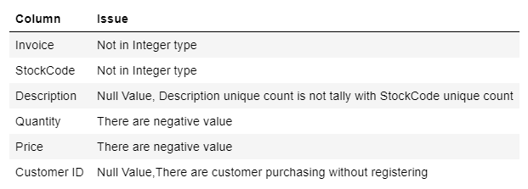
This dataframe consist data from 2009-12-01 07:45:00
This dataframe consist data ends on 2011-12-09 12:50:00
There are in total 738 days 05:05:00 days of observations.
The duration of the dataset is for 25 months.
Dataset
Source:https://archive.ics.uci.edu/ml/datasets/Online+Retail+II

Slide 8
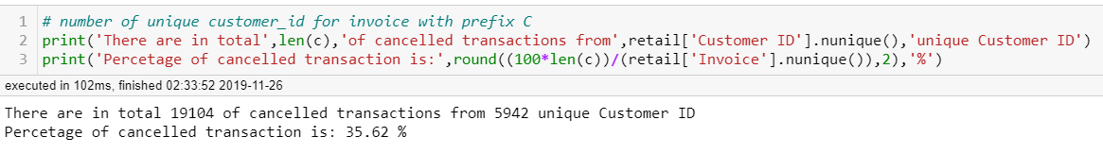
Data Cleaning
Removed
34,335 Duplicates rows
19,110 rows of with Invoice
Prefix 'C' & 'A' (Cancelled:35.62%)
4,275 rows with null Customer ID information,transactions made by customer from United Kingdom with $0.0 pricing.
230,156 rows with null Customer ID information
70 rows with Customer ID but '$0.0 price.might be FOC items for csutomers

Slide 9
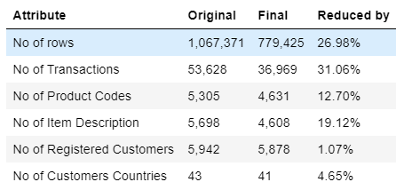
Data Cleaning
There are in total 4,631 unique stockcodes but there are 4,608 item description.
Single stockcode is assigned with mutiple descriptions with different format (some with spacing, some with symbol '+' instead of spacing.
First description was used for standardization purposes.
There are 21 Description with multiple stcokcodes.Further Cleaning is not done at this stage

Slide 10
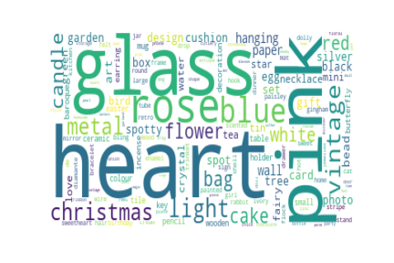
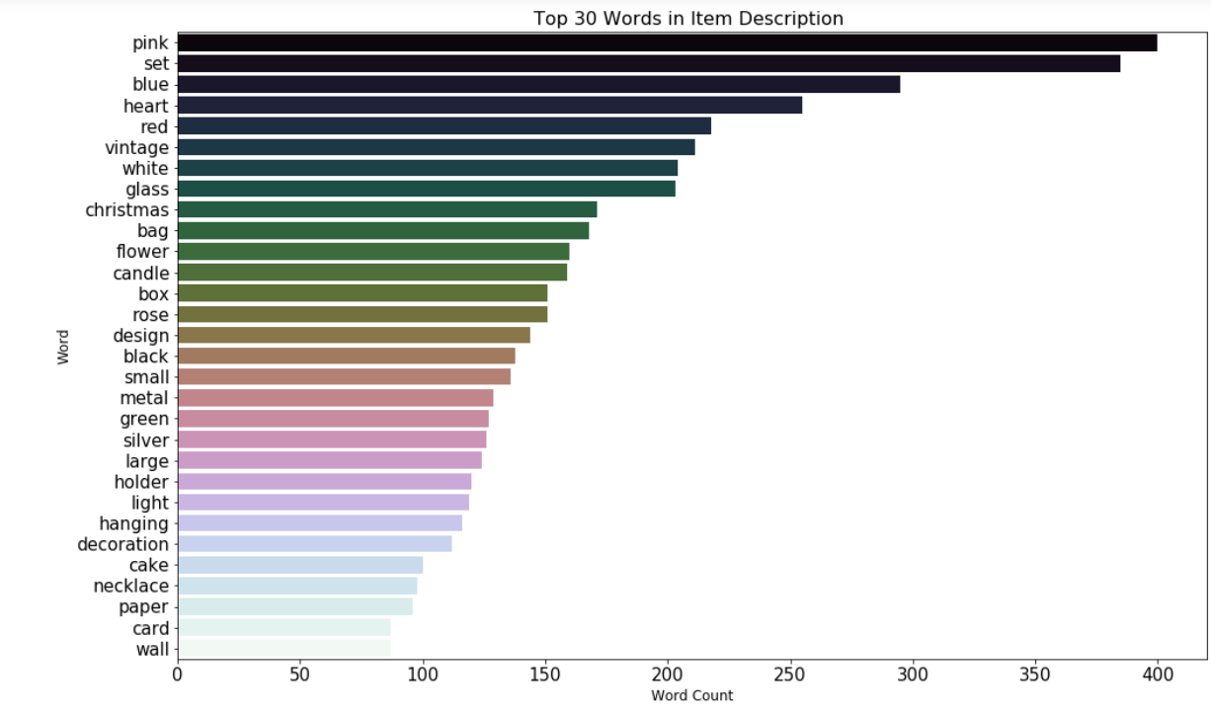
EDA- Item Level
4,608 item description uncatagorized

Slide 11
EDA- Item Level
?

Slide 12
Based on the trans41 types of items with a total revenue of $ 8425.54.
EDA- Transaction Level
Average
Highest Revenue
Highest
Qty
Highest
Variety
284 Qty
21 Items
$469.98
80,995 Qty
1 Items
$ 168,469
87,167 Qty
45 Items
$ 11,880
2,175Qty
541 Items
$ 8,425

Slide 13
Based on the trans41 types of items with a total revenue of $ 8425.54.
EDA- Customer Level
Average
Highest Revenue
Highest
Qty
Highest Frequency &
Variety
6 Transactions
1,789 Qty
84 Items
$2,956
ID:18102
145 Transactions
181,645 Qty
413 Items
$ 580,987
ID:14646
151 Transactions
367,193 Qty
1,055 Items
$ 528,602
ID:14911
398 Transactions
147,972 Qty
2,746 Items
$ 291,420

Slide 14







EDA- Country Level
Highest Revenue
Highest Customer Count
Highest Transaction Count
$ 14,389,234
5,350
33,541
$ 616,570
107
789
Average
144 Customers
902 Transactions
2,564 Qty
718 Items
$423,776
$ 554,038
95
641
$ 425,019
41
567
29
228
$ 348,768

Slide 15
The concept of recency, frequency, monetary value (RFM) is thought to date from an article by Jan Roelf Bult and Tom Wansbeek, "Optimal Selection for Direct Mail," published in a 1995 issue of Marketing Science. (Investopedia) RFM analysis is based on the marketing axiom that "80% of your business comes from 20% of your customers. (Pareto Rule).
RFM Analysis
The concept of recency, frequency, monetary value (RFM) is thought to date from an article by Jan Roelf Bult and Tom Wansbeek, "Optimal Selection for Direct Mail," published in a 1995 issue of Marketing Science. (Investopedia)

Slide 16
Avg_Item_Types_Per_Inv
Features
8 Features
Customer ID
Invoice Date
Invoice No
StockCode
Item Description
Quantity
Price
Country
Recency : Time Since Last Purchase (days)
Frequency : Total Number of Transactions
Monetary : Total Monetary Value
Tenure : Time Since First Purchase (days)
Min_Item_UnitPrice
Max_Item_UnitPrice
Median_Item_UnitPrice
Avg_Spending_Per_Inv
Avg_Purchase_Qty_Per_Inv
Avg_Item_Types_Per_Inv
No of months with transaction
Ratio_Transaction_Per_Unique_Mth
Ratio_Spending_Per_Unique_Mth
Avg_Spending_Per_Mth
Avg_Transaction_Per_Mth

Slide 17
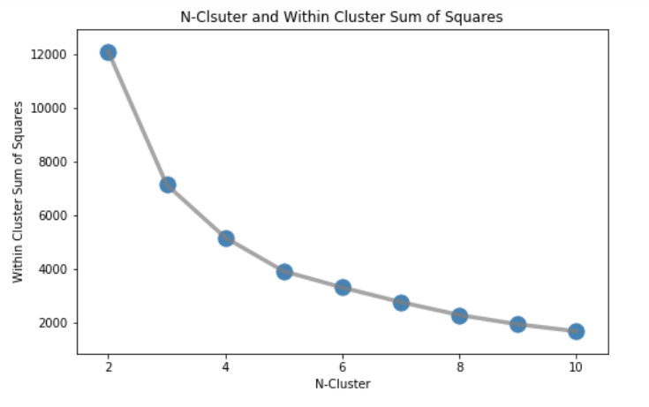
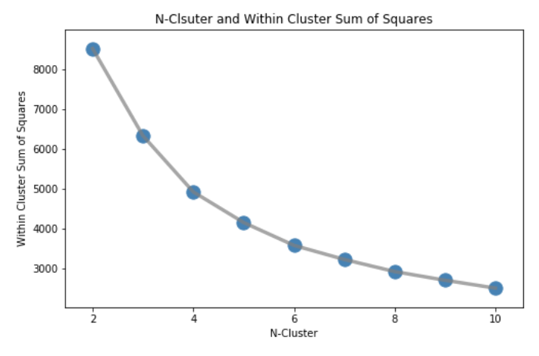
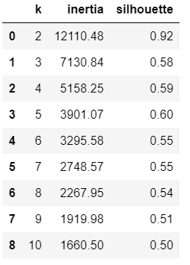
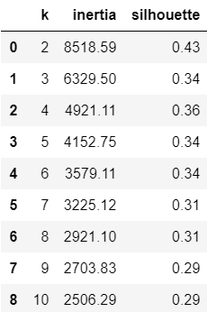
The concept of recency, frequency, monetary value (RFM) is thought to date from an article by Jan Roelf Bult and Tom Wansbeek, "Optimal Selection for Direct Mail," published in a 1995 issue of Marketing Science. (Investopedia) RFM analysis is based on the marketing axiom that "80% of your business comes from 20% of your customers. (Pareto Rule).
RFM Silhouette Score & Elbow Method
log

Slide 18
Modeling-KMeans with RFM Value as features, k=5
 | Best Customer | Loyal | Rookies/ Potential Loyal | Hibernating | Needs Attention/ Loosing Soon
Percentage | 0.07% | 0.41% | 6.38% | 60.58% | 32.56%
No of Customer | 4 | 24 | 375 | 3,561 | 1,914
R | 4 | 23 | 29 | 76 | 472
F | 213 | 120 | 29 | 5 | 2
M | $ 428,612 | $ 98,957 | $13,663 | $ 1,878 | $ 739
Action | Reward | Upsell & Engage | Offer Loyalty Program | Offer other / Recreate Brand Value | Reactive using recommendation based on past purchase

Slide 19
Modeling-KMeans with RFM Value as features (log), k=5
 | Best Customer | Loyal | Rookies/ Potential Loyal | Hibernating | Needs Attention/ Loosing Soon
Percentage | 9.75% | 21.25% | 18.48% | 23.15% | 27.37%
No of Customer | 573 | 1,249 | 1,086 | 1,361 | 1,609
R | 11 | 66 | 29 | 301 | 408
F | 28 | 9 | 3 | 4 | 1
M | $ 17,116 | $ 3,773 | $ 727 | $ 1,213 | $ 257
Action | Reward | Upsell & Engage | Offer Loyalty Program | Offer other / Recreate Brand Value | Reactive using recommendation based on past purchase

Slide 20
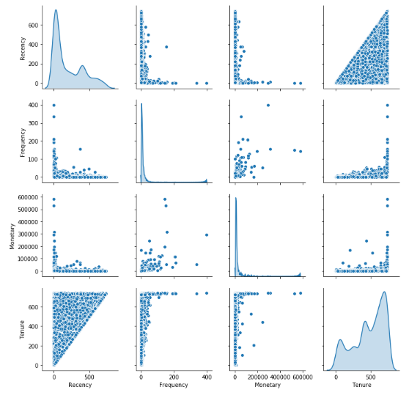
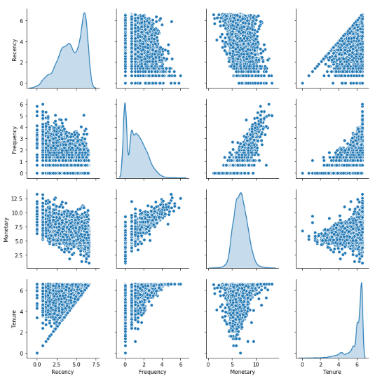
RFMT Value Data Distribution
Log

Slide 21
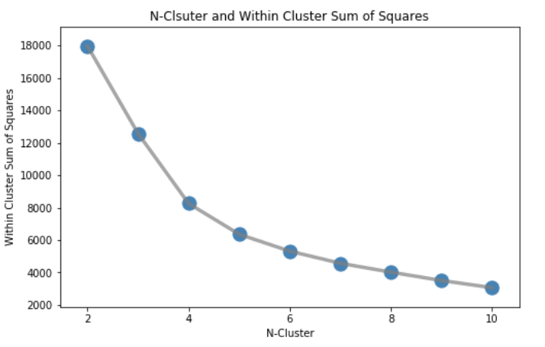
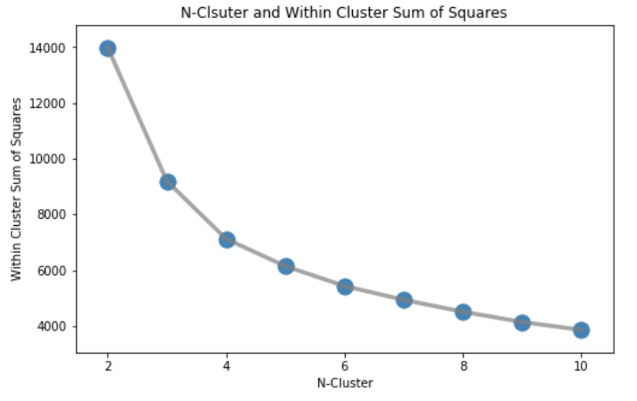
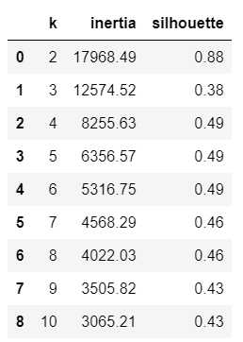
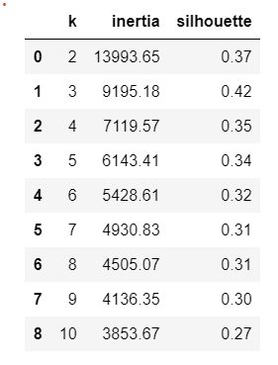
The concept of recency, frequency, monetary value (RFM) is thought to date from an article by Jan Roelf Bult and Tom Wansbeek, "Optimal Selection for Direct Mail," published in a 1995 issue of Marketing Science. (Investopedia) RFM analysis is based on the marketing axiom that "80% of your business comes from 20% of your customers. (Pareto Rule).
RFMT Silhouette Score & Elbow Method
log

Slide 22
Modeling-KMeans with RFMT Value as features, k=5
 | Best Customer | Loyal | Rookies/ Potential Loyal | Hibernating | Needs Attention/ Loosing Soon
Percentage | 0.07% | 0.60% | 30.61% | 37% | 31.72%
No of Customer | 4 | 35 | 1,799 | 2,175 | 1,856
R | 4 | 26 | 86 | 66 | 476
F | 213 | 104 | 3 | 11 | 2
M | $ 428,612 | $ 81,356 | $ 996 | $ 4,415 | $ 760
T | 739 | 705 | 191 | 630 | 564
Action | Reward | Upsell & Engage | Offer Loyalty Program | Offer other / Recreate Brand Value | Reactive using recommendation based on past purchase

Slide 23
Modeling-KMeans with RFMT Value as features (log), k=5
 | Best Customer | Loyal | Rookies/ Potential Loyal | Hibernating | Needs Attention/ Loosing Soon
Percentage | 18% | 17% | 11.7% | 23.9% | 29.4%
No of Customer | 1,063 | 1,008 | 686 | 1,403 | 1,718
R | 29 | 32 | 43 | 253 | 430
F | 21 | 4 | 2 | 5 | 1
M | $ 11,749 | $ 1,280 | $ 591 | $ 1,881 | $ 321
T | 645 | 406 | 59 | 600 | 474
Action | Reward | Upsell & Engage | Offer Loyalty Program | Offer other / Recreate Brand Value | Reactive using recommendation based on past purchase

Slide 24
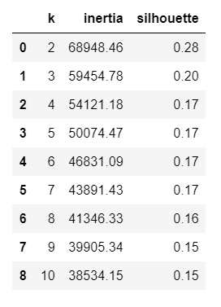
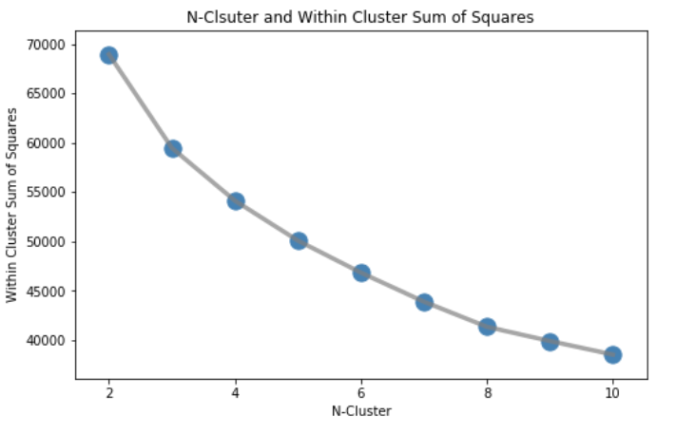
The concept of recency, frequency, monetary value (RFM) is thought to date from an article by Jan Roelf Bult and Tom Wansbeek, "Optimal Selection for Direct Mail," published in a 1995 issue of Marketing Science. (Investopedia) RFM analysis is based on the marketing axiom that "80% of your business comes from 20% of your customers. (Pareto Rule).
Customer Features
Silhouette Score & Elbow Method

Slide 25
Modeling-KMeans with Customers' features (log), k=4
 | Best Customer | Loyal | Hibernating | New
Percentage | 18.66 % | 35.34 % | 14.78 % | 31.22 %
No of Customer | 1,097 | 2,077 | 869 | 1,835
R | 49 | 142 | 353 | 290
F | 20 | 5 | 2 | 1
M | $ 11,885 | $ 1,550 | $ 256 | $ 487
T | 622 | 522 | 431 | 356
Qty | 7,244 | 933 | 85 | 303
Type | 229 | 85 | 9 | 32
Action | Reward | Upsell & Engage | Offer other / Recreate Brand Value/Reactive using recommendation based on past purchase | Offer Loyalty Program

Slide 26
Modeling-KMeans with Customers' features (log), k=4 (cont')
 | Best Customer | Loyal | Hibernating | New
Percentage | 18.66 % | 35.34 % | 14.78 % | 31.22 %
No of Customer | 1,097 | 2,077 | 869 | 1,835
Avg Trans Per Month | 0.8 | 0.21 | 0.07 | 0.06
Avg Spending Per Month | $ 475 | $ 62 | $ 10 | $ 19
Avg Spending Per Inv | $ 707 | $ 331 | $ 158 | $ 362
Avg Qty Per Inv | 528 | 200 | 52 | 226
Avg Item Types Per Inv | 16 | 18 | 2 | 24
No of unique months transaction | 11 | 5 | 2 | 1
Ratio Trans Per Unique Month | 1.64 | 1.2 | 1.09 | 1.07
Ratio Spending Per Unique Month | $ 1,169 | $ 386 | $ 184 | $ 379

Slide 27
Modeling-KMeans with Customers' features (log), k=4 (cont')
 | Best Customer | Loyal | Hibernating | New
Percentage | 18.66 % | 35.34 % | 14.78 % | 31.22 %
No of Customer | 1,097 | 2,077 | 869 | 1,835
Avg Trans Per Month | 0.8 | 0.21 | 0.07 | 0.06
Avg Spending Per Month | $ 475 | $ 62 | $ 10 | $ 19
Avg Spending Per Inv | $ 707 | $ 331 | $ 158 | $ 362
Avg Qty Per Inv | 528 | 200 | 52 | 226
Avg Item Types Per Inv | 16 | 18 | 2 | 24
No of unique months transaction | 11 | 5 | 2 | 1
Ratio Trans Per Unique Month | 1.64 | 1.2 | 1.09 | 1.07
Ratio Spending Per Unique Month | $ 1,169 | $ 386 | $ 184 | $ 379

Slide 28
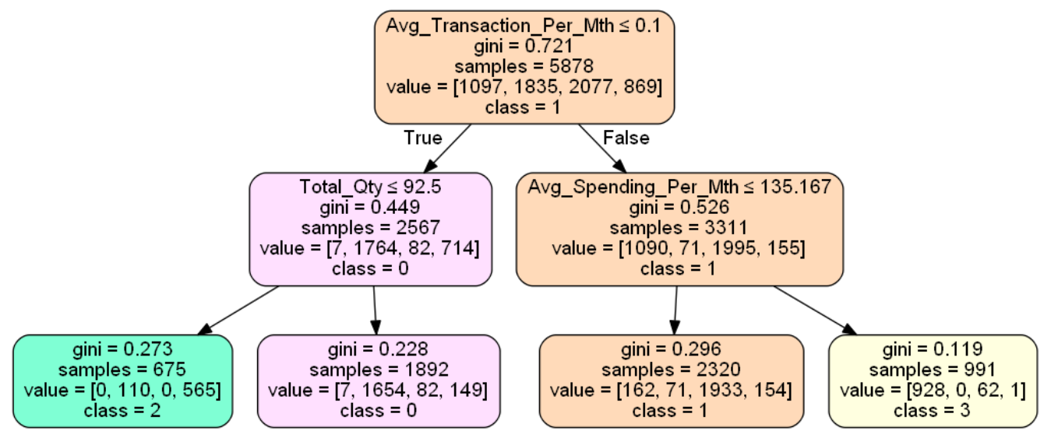
Fit the cluster result into Decision Tree, max depth=2
# Customer: 869
“Hibernating”
# Customer: 1,835
“New”
# Customer: 2,077
“Loyal”
# Customer: 1,097
“Best”

Slide 29
Modeling-KMeans with Customers' features (log), k=4
 | Best | Loyal | Hibernating | New
Percentage | 18.66 % | 35.34 % | 14.78 % | 31.22 %
No of Customer | 1,097 | 2,077 | 869 | 1,835
Avg Trans Per Month | 0.8 | 0.21 | 0.07 | 0.06
Avg Spending Per Month | $ 475 | $ 62 | $ 10 | $ 19
Qty | 7,244 | 933 | 85 | 303

Slide 30
Modeling-KMeans with All Customers' Features, k=6
 | Loyal | Potential Loyal | About to Sleep | Needs Attention | Hybernating | Lost Whale
No of Customer | 20 | 1,610 | 106 | 154 | 3,986 | 2
R | 25 | 48 | 132 | 230 | 266 | 629
F | 146 | 14 | 7 | 4 | 3 | 2
M | $ 183,568 | $ 6,048 | $ 4,009 | $ 2,932 | $ 769 | $ 12,435
T | 661 | 590 | 305 | 207 | 147 | 1
Action | Reward, Upsell & Engage | Offer Loyalty Program | Reconnect with them, Recommend popular product | Reactive using recommendation based on past purchase | Offer other / Recreate Brand Value | Reach out to them

Slide 31
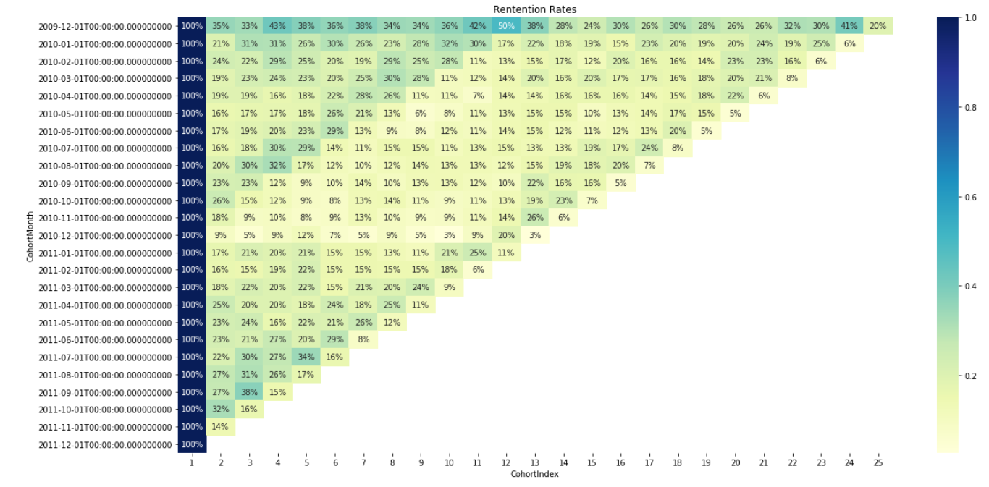
Cohort Analysis : Retention Rate
Nov
Overall Retention Rate= 18. 41%
Overall Churn Rate = 81.59 %

Slide 32
678.84
Customer Lifetime Value
Overall Retention Rate= 18. 41%
Overall Churn Rate = 81.59 %
Traditional Customer Lifetime Value
Average Revenue Per Customer Per Month
Overall Retention Rate
*
Profit
Margin
=
*
Overall Churn Rate
*
18.41
=
$ 678.84
81.59
=
$ 101.99

Slide 33
The concept of recency, frequency, monetary value (RFM) is thought to date from an article by Jan Roelf Bult and Tom Wansbeek, "Optimal Selection for Direct Mail," published in a 1995 issue of Marketing Science. (Investopedia) RFM analysis is based on the marketing axiom that "80% of your business comes from 20% of your customers. (Pareto Rule).
Conclusion & Recommendation
After this unsupervised machine learning has learnt on features, number of cluster and labeled clusters, supervised machine learning like classification can be done for new data.
Further work can be done on clustering and categorizing products into a few categories and include items purchased as one of the features in KMeans Clustering.

Slide 34
THANK YOU

